Slide 1
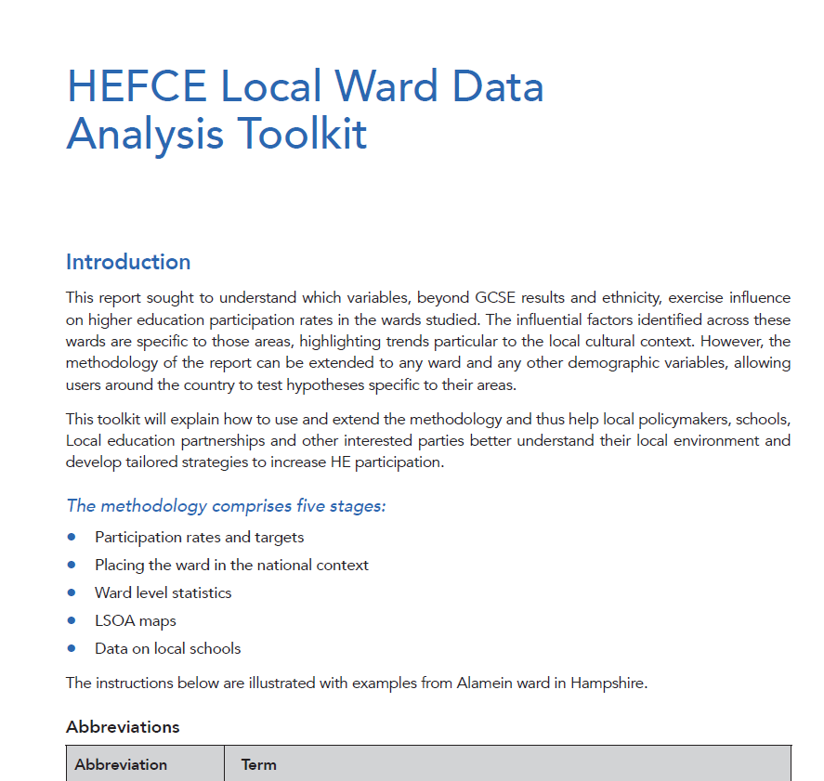
The Data Analysis Toolkit
What is it?
What is in it?
How was it developed?
How to use it?
Things to watch out for

Slide 2
What Is It?
Seven page document plus three supporting spreadsheets
Assistance for reproducing data analysis on other wards
Aimed at non-specialist audience
Only requires common PC desktop tools (primarily Excel or similar)
Open
Freely available to anyone to use and modify
Expect users to change and improve it

Slide 3
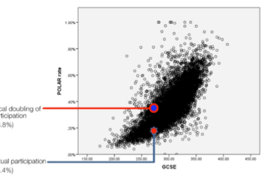
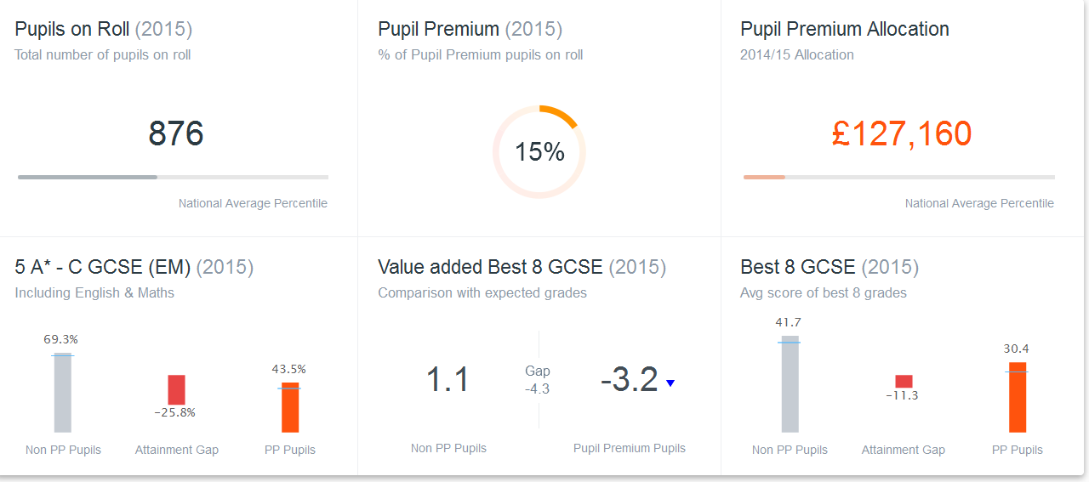
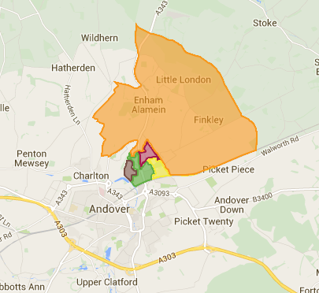
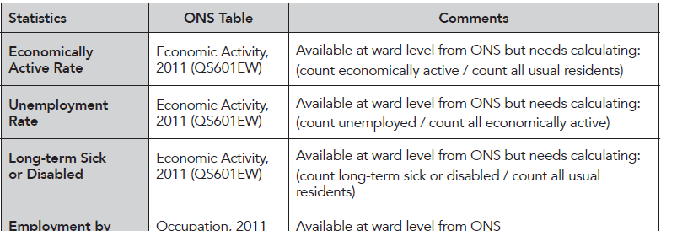
What is in it?
Step by step guidance on creating
Participation rates and targets
Placing ward in national context
Ward level statistics
LSOA maps
Local school data
Illustrated with examples from Alamein and Newport South wards
Three spreadsheets containing data not easily available on the Internet

Slide 4
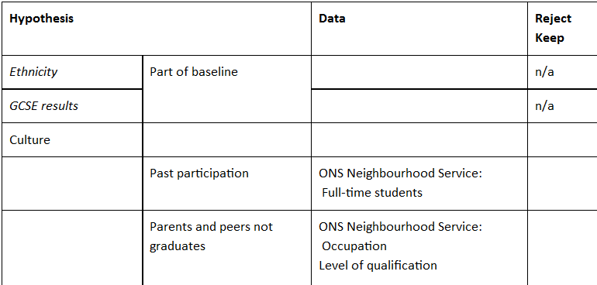
How was it developed?
Long list of relevant open datasets
Consult with education experts to prioritise and reduce list
In practice came down to HEFCE, ONS and DoE
Some important data not easily available openly e.g. HEFCE and Local Authority

Slide 5
How to use it?
Decide which sections you are interested in
Follow guidance for those sections
(may need technical assistance with some parts e.g. LSOA maps)
Adapt as you wish for your needs
Feedback suggested improvements

Slide 6
Things to watch out for
POLAR versus GAPS
Different measures of participation
GAPS is maintained schools only, POLAR is all schools
POLAR tends to be higher (but not always)
Also different cohort sizes
Dates
A lot of the demographic data gathered at last census i.e. 2010 (graduate parent data previous census 2000!)
Education data is more up to date
Cohort sizes
A big % change may be equivalent to just a few children a year
Often averaged over 5 years – change over time may be hidden
Ward names and boundaries change
Ward sizes vary immensely (Newport S: 3777, Coxford 14,046)
LSOAs are more consistent – about 1,500
Alamein | Participation | Cohort
GAPS | 12.7% | 124
POLAR | 10.9% | 138
 | Average cohort size | Actual participation | HEFCE expected participation
Participation rate |  | 17.6% | 25.5%
Children per year | 38 | 7 | 10

Slide 7
In conclusion ….
Should be a useful tool (bearing in mind previous chart)
Allow 2-3 days per ward assuming Excel and Internet skills
It is yours to modify as you wish
Please feedback comments and improvements
Good luck!

Slide 8
Points for workshop
Calculating participation rates
POLAR versus GAPS
Extrapolating cohort sizes to 2020
Estimating POLAR from GAPS
Scatter diagrams
Missing data points
Changing ward boundaries and names
Open not a very meaningful term
Some data “sort of open” e.g. HEFCE GAPS participation, LSOA to ward
Most data was ONS/DoE which was freely available before there was an open data movement
Very easy to overstate the significance of numbers
LSOA clusters
Big percentage changes in small numbers

