Slide 1

Using data to create localised widening participation strategies
Notes:
I am chair of the Southern Policy Centre.
SPC is a small, independent, think tank and policy forum for central southern England.
We have three particular areas of interest:
Public policy, where most of our work has been on local devolution
Open data – and its application to public policy
And innovative forms of public participation where we have undertaken deliberative polling for local authorities, and supported the ESRC funded citizens assembly south

Slide 2
2015 HEFCE ‘Participation GAPS’
http://www.hefce.ac.uk/analysis/yp/gaps/
Notes:
Just to give you some background to this project
In 2015, HEFCE published an interactive map of the ‘participation gap’. [Illustrate this – explain that familiar ti the HE audience but not necessarily to the open data audience]
The wards where HE participation was lower even than expected by GCSE and ethnicity- the two most strongly correlated with participation.
The Southern Policy Centre had just been launched as a think tank for central southern England – public policy and open data
Seemed ideal opportunity - proposed to HEFCE to look at open and easily accessible data to see if we could shed light on this. And then derive localized wp strategies.
Project started last summer.
Since then NCOP programme announced.
And new government targets to increase participation, doubling the participation from the 20% of wards with the lowest participation.
I’m going to run through the type of data we have looked at.
Then Ceri Nursaw will show how an experienced practitioner can use the data to being to develop a localized approach. Finally, Mark Frank – who did most of the data analysis – will present the toolkit designed to enable other to do the same analysis for other wards.

Slide 3
Widening participation targets
We ask how the target ward compares with every other ward in England in terms of participation levels against GCSE attainment.
Paulsgrove: Average Capped GCSE Score (2007 to 2011)
Notes:
The first step was to produce a scattergram of every ward in England, mapping participation rate against key indicators like GCSE outcomes, ethnicity etc
This enables us to see where our ward sits. (See here- at the bottom of participation rate for similar levels of GCSE).

Slide 4
Approach: targets
National average Q1 target
Double current participation rate
Estimated participation gap
Where we are today
Alamein
Notes:
This approach lets us show how the various different targets map onto our ward.
The HEFCE participation gap. And the government targets.
The government has set a national target, to double participation from POLAR Q1 wards(the lowest participation 20% of wards), to achieve a national average of 28% by 2020
The government has not set a ward by wad target, so we have explored two possible interpretations
doubling the participation in an individual ward
taking the ward participation to the 28% national average target
Slight of hand. HEFCE gap measured on a different basis to POLAR (essentially excluded private schools). For simplicity we have recalculated the HEFCE gap on a POLAR basis – makes some assumptions but, we think, nothing to worry about too much)

Slide 5
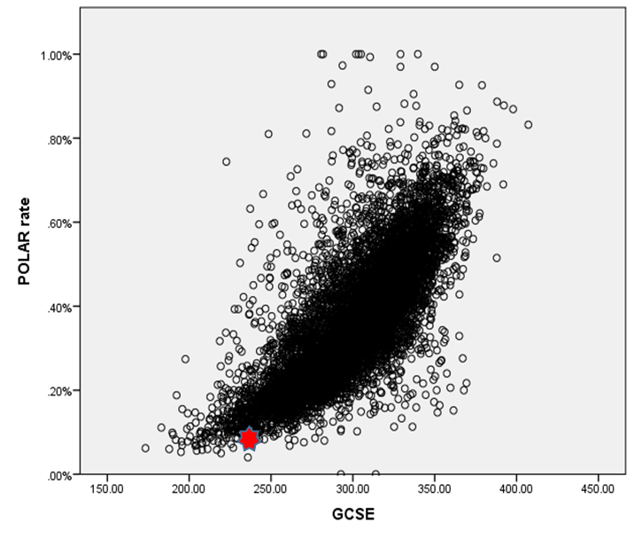
widening participation targets
How achievable is the HEFCE target without school improvement?
Paulsgrove
HEFCE expected (15.5%)
National mean POLAR Q1 target (28%)
Local doubling of participation (16.6%)
HEFCE target
Raise participation to the level of other wards with similar GCSE attainment and ethnic profile.
Government target
Raise average participation of POLAR Q1 wards to 28% nationally.
We address this by investigating:
  Doubling participation in Q1 wards
  Raising all Q1 wards to 28%
Notes:
This slides separates out the targets for clarity. It helps us see how challenging the targets will be.
What this shows is that – as you would expect – closing the HEFCE participation gap looks quite achievable with current GCSE performance. By definition bringing up to average.
But also shows that getting to 28% - the new national average by 2020 would be remarkable with current levels of GCSE performance. Doubling in the individual ward is only a little more challenging than closing the gap.
Distinction is important
Firstly makes improvement seem more attainable if you know others are doing it
- Secondly, begins to indicate where incremental improvement might need to become something more transformational.

Slide 6
Data quality
Targets are set against old data.
Most recent HE participation data my be reflecting school & WP outreach activity performance from several years ago.
We use the most recent data but recognize the importance of establishing with stakeholders whether there have been ground level changes.
Notes:
A few key points about data
Some of it is old
May reflect past conditions on the ground that no longer apply
Could go back and look for 10-15 year old primary school data which would relate to most recent participation stats. But think more useful to look at most recent figures.
This data is a discussion starter – issues to look at. Does not enable us to reach firm conclusions, let alone judgments about what is happening on the ground.

Slide 7
Approach: Ward comparison
Alamein local doubling of participation (21.8%)
Paulsgrove local doubling of participation (16.6%)
The achievability of a local doubling of participation based on current GCSE attainment varies between wards.
A doubling of participation in Paulsgrove would place it closer to average wards with similar performance. Alamein would need to become a top performing ward at its level of GCSE attainment to meet the same target.
Notes:
At first sight very similar – as Ceri will say –
But not as similar as might think.
Doubling is much more stretching in Alamein than Paulsgrove.

Slide 8
Correlating factors: Unemployment
Newport South
Coxford
Higher unemployment tends to correlate with lower participation. These wards perform particularly badly for their levels of unemployment.
Notes:
Some common features in our wards
levels of unemployment are somewhat higher than the national average, but not so high as to explain the poor participation. What is striking is that we see here two particularly poor levels of participation for those levels of unemployment.
This begins to make us think we need to know more about the local labour market to understand what is going on here. As will see, later today, despite similarities of headline figures, labour markets are quite different.
[Not included in this presentation but will see Ceri draws on this, and in Mark’s toolkit.]

Slide 9
Correlating factors: Social housing
Alamein
Coxford
Some wards present challenges as they are outliers in their variable. As illustrated, Alamein is more challenging than Coxford because there are relatively few comparable wards.
Notes:
The wards varied quite a bit on their levels of social housing.
And in the more detailed level we shall come to in a moment, varied as to the extent to which areas with high concentrations of social housing were correlated with very localised education outcomes.
Here highlighted an interesting feature.
Both these wards relative outliers – and in case of Alamein, very few comparator wards.
This suggests that we may need to develop widening participation strategies that have a particular engagement with social housing providers and tenants

Slide 10
Correlating factors: parental education
Paulsgrove
Newtown
Coxford
Level of parental education correlates strongly with HE participation, but these wards still perform badly compared with other wards with low levels of parental education.
Notes:
Another significant factor has been parental education
We mapped at both graduate and level 4 – shown various here. Patterns much the same
again, our wards have lower than average levels of parental education but tend to do poorly for the levels they do have
the levels of parental education do, however, give some indication of the social capital you may have to work with.

Slide 11
Approach: Ward comparison - Coxford
Based on the analysis, a WP strategy would need to engage with parental views of education, in-work education and social housing providers.
Ethnic minority and unemployed parents are not major target groups.
Notes:
You can begin to bring this together
In Coxford, here in Southampton, the data tends to suggest the outlines of an approach – though as I have said before , this then needs to be checked out with local stakeholders.
That the families who need most attention are likely to be in work, in relatively low skilled jobs, with relatively poor qualifications/experience of learning. Many may be social housing tenants.
While a limited strategy might concentrate on those who are already getting decent GCSEs, anything more obvious may need to try to reach those parents through some of employers, landlords and community education.

Slide 12
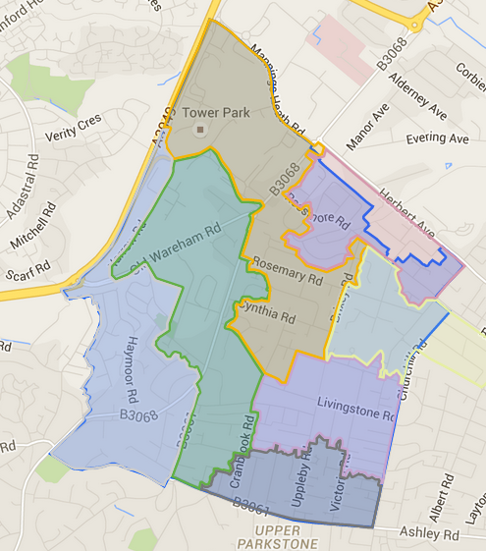
Understanding the Area: lsoas
Lower Super Output Areas offer detailed geographical insight whilst remaining manageable.
8E
8D
8B
8F
11A
8A
8C
Newtown ward LSOAs
Notes:
The second phase is to look at more local data.
We used LSOAs.
Can go smaller but law of diminishing returns. The smaller the area, the more volatile the data. A few people can become a huge % swing.
And we are trying to find questions to raise, not definitive answers.

Slide 13
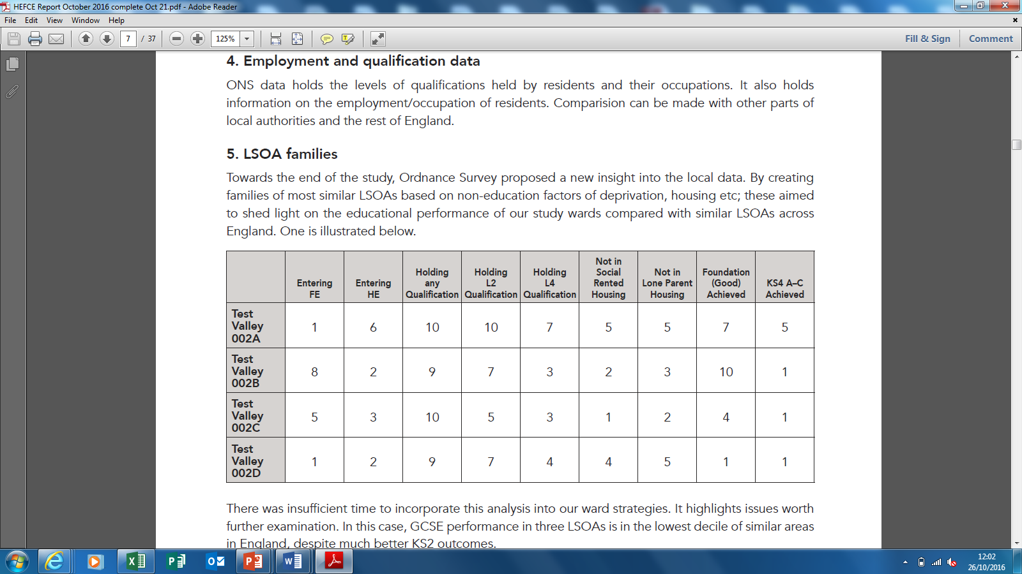
Understanding the Area: lsoa’s
We compare education indicators for each LSOA with it’s family of most similarly deprived/wealthy LSOAs.
For the LSOAs with the lowest level of HE participation, two features stand out.
Primary school performance varies widely, from amongst the best to amongst the worst. But GCSE performance is amongst the ‘worst in family’ for each low participation LSOA. This suggests that progression post primary school is a critical issue.
Parents have higher numbers of low level qualifications, but below comparable LSOAs on higher level qualifications, reinforcing the case for greater parental engagement.
Notes:
I’ve included this table, even though not referred to in Ceri’s presentation as it is referred to in the toolkit
We worked with Ordnance Survey on various aspects of this project. Towards the end of the project they suggested looking at each LSOA and comparing it with the most similar LSOAs in England, using all the usual data on the index of multiple deprivation but excluding key educational outcomes. A way of seeing how the educational data varied in similar wards.
We compare education indicators for each LSOA with it’s family of most similarly deprived/wealthy LSOAs. Details are in the toolkit.
For the LSOAs with the lowest level of HE participation, two features stand out.
Primary school performance varies widely, from amongst the best to amongst the worst. But GCSE performance is amongst the ‘worst in family’ for each low participation LSOA. This suggests that progression post primary school is a critical issue.
Parents have higher numbers of low level qualifications, but below comparable LSOAs on higher level qualifications, reinforcing the case for greater parental engagement

Slide 14
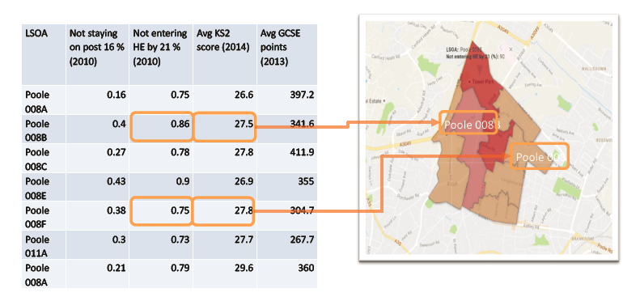
Understanding the Area: lsoa’s
Potential insights from this data:
We can locate low participation areas more clearly.
Notes:
The data at LSOA level can provide a wealth a detail. Density of social housing, numbers of single parents, participation in higher education etc.
Can raise many questions; in these next few slides I’ve looked simply at some of the educational outcome data.
We can see where improvement is achievable.
We can see anomalies that should be explored
Here for example – highlights low participation areas. 08B and 08E have the smallest numbers in HE by 21.
But also interesting issues
08B and 08F have very similar KS2 outcomes, not wildly different participation rates in FE, but very different HE entry. Something that is worth raising locally to look for explanation.

Slide 15
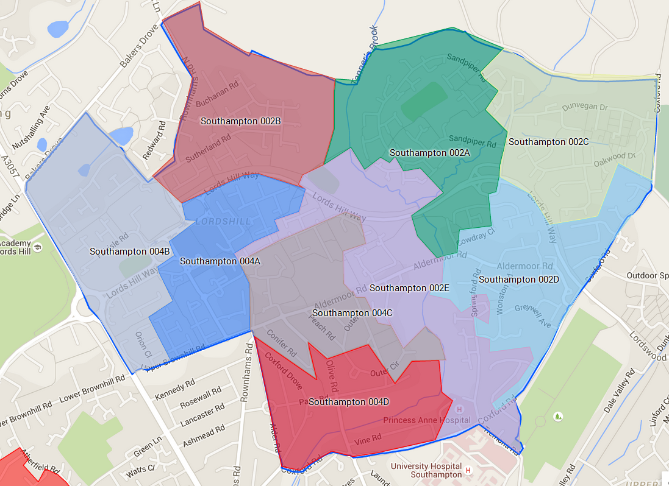
Understanding the Area: lsoa’s
LSOA | Avg KS2 score boys (2014) | Avg GCSE points boys (2013) | Avg KS2 score girls (2014) | Avg GCSE points girls (2013)
002A | 31.3 | 410.7 | 30.8 | 394.1
002B | 29.3 | 318 | 30 | 490.3
002C | 27.8 | 331.4 | 28.5 | 442
002D | 27.7 | 316.9 | 27.7 | 393.1
002E | 29 | 314.9 | 29 | 421
004A | 27.2 | 289.4 | 30.4 | 328.4
004B | 30.9 | 233.3 | 25.1 | 384.3
004C | 30.6 | 265.9 | 28.8 | 390
004D | 28.8 | 300.2 | 29.3 | 341.3
Attainment by gender in Coxford
Potential insights from this data:
We can identify other challenges such as different performance between boys and girls in different areas of a ward.
Notes:
E can look at things like gender outcome as GCSE.
These two areas of Coxford have remarkable different gender outcomes.
It could be a statistical fluke of timing. May be there is something real on the ground to understand.

Slide 16
Understanding the area: Education outcomes
LSOA | Avg KS2 score boys (2014) | Avg GCSE points boys (2013) | Avg KS2 score girls (2014) | Avg GCSE points girls (2013)
001A | 27.9 | 342.9 | 27.3 | 316.2
001B | 27.5 | 262.4 | 27.8 | 338
001C | 23.4 | 294.7 | 28.7 | 272.6
001D | 27.2 | 221.1 | 26.4 | 295
001E | 28.1 | 246.5 | 26.8 | 323.5
002D | 27.3 | 220.6 | 28.5 | 339
004B | 28 | 327.7 | 28.3 | 308
004C | 22.5 | 257 | 27.8 | 359.9
004D | 27.2 | 269.3 | 29.4 | 314.4
004C = Largest KS2 gender gap
001B = Largest GCSE gender gap
Breaking wards down by LSOA, we can investigate:
Year 7 attainment (and by gender)
GCSE attainment (and by gender)
Notes:
And we can look at KS2 and GCSE outcomes.
Here we have highlighted 4C - biggest gender gap at KS3
And 01B – biggest gender gap at GCSE
Not obvious what this is telling us, except that it does not show a pattern of gender difference repeated at GCSE in the same areas as KS2

Slide 17
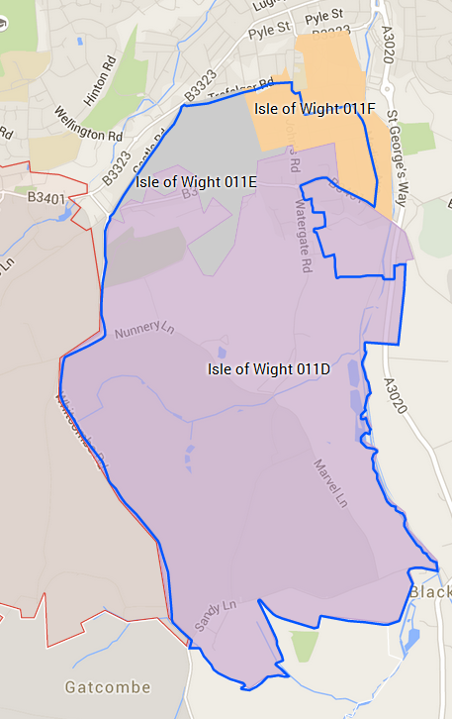
Understanding the Area: lsoa’s
LSOA | Not staying on post 16 (2010) | Not entering HE by 21 (2010) | Avg KS2 score (2014) | Avg GCSE points (2013)
011D | 17% | 60% | 30.9 | 312.50
011E | 6% | 88% | 27.9 | 285.70
011F | 49% | 76% | 29 | 350.40
Potential insights from this data:
We can highlight anomalies where performance is above/below other LSOAs in the ward.
Rather than providing ‘proof’ of obstacles to WP in relevant wards, they facilitate a focused discussion with local stakeholders.
HE participation in Newport South
Notes:
We can sometimes see details that are crying out for an explanation.
In 11F on the Island, half of young people don’t stay on at 16, but of those that do, half go the university by 21.
In 11E it appears that 90% stay on at 16, but only 12% have gone to university by 21.

Slide 18
Understanding the area: Education outcomes
LSOA | Not staying on post 16 (2010) | Not entering HE by 21 (2010) | Avg KS2 score (2014) | Avg GCSE points (2013)
001A | 28% | 92% | 27.6 | 326.5
001B | 30% | 93% | 27.6 | 278.3
001C | 17% | 92% | 26.9 | 286.2
001D | 24% | 91% | 26.8 | 258
001E | 22% | 91% | 27.7 | 273.6
002D | 34% | 94% | 27.8 | 292.7
004B | 14% | 71% | 28.2 | 317.9
004C | 20% | 77% | 25.1 | 313.1
004D | 40% | 76% | 28.7 | 285.1
004C & 004D = Equal GCSEs, different rates not entering HE by 21.
Breaking wards down by LSOA, we can investigate:
Post GCSE attainment
This shows us where the need to improve performance is most marked.
Notes:
And here
1C and 4D. Very similar GCSE results – very different HE entry.
So if we are looking to identify those students who do well at GCSE, but who do not go onto the university, begin to have an idea where they might live.

Slide 19
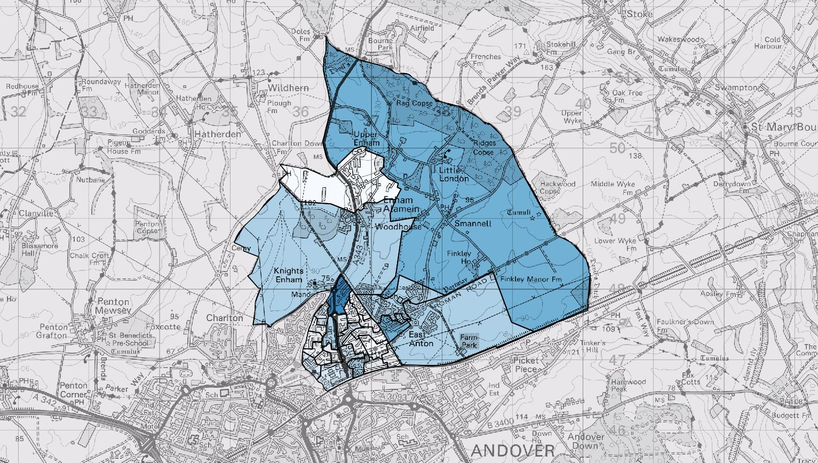
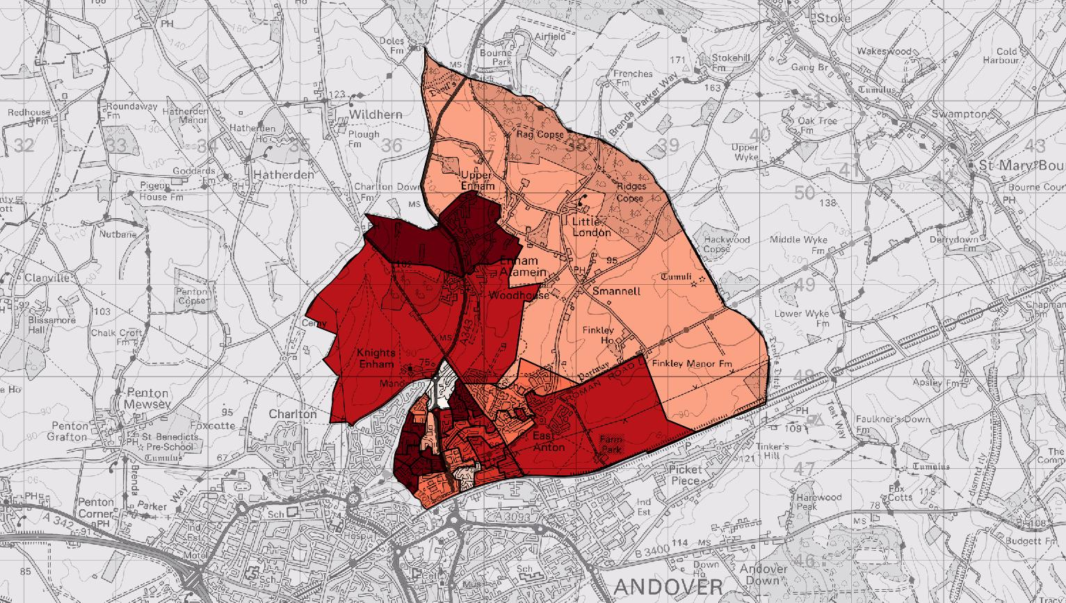
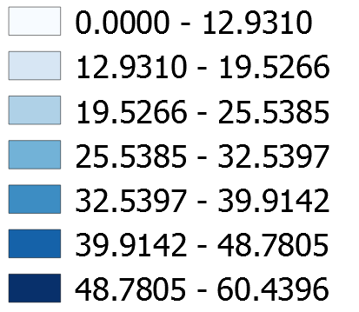
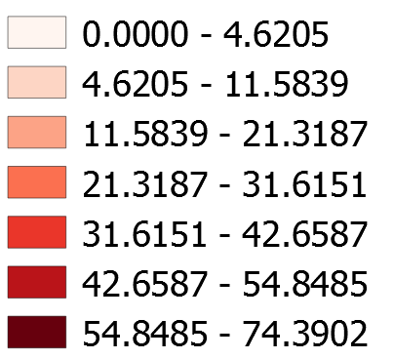
Understanding the Area: lsoa’s
Non-degree holding adults (post 21) in Alamein
Social housing in Alamein
Potential insights from this data:
We can highlight the areas where our ‘low participation characteristics’ are strongest.
Notes:
Mapping data such as social housing and parental education levels onto the ward enables us to see more clearly that challenges are rarely uniform across a ward – certainly for the larger wards.
Here for example, in Alamein, Andover. The lowest levels of parental education are concentrated in the urban areas, and with some parts of the urban area. Broadly corresponds to social housing.
Even a local ward wide approach might not be the most effective. May be necessary and sensible to target within the ward

Slide 20
Understanding the area: Schools
Open source data does not allow us to identify the passage of individual students through schools and college. We therefore:
Cannot relate this local performance to the outcomes of schools and colleges.
Cannot establish how each local cohort performs in an individual school or college.
Notes:
From a data point of view – if not a privacy point of view – we would like to be able to track every student right through the system.
We would like to be able to track a whole cohort, but again we cannot as, particularly post 16, the easily available data switches away from geographic information.
But we can find useful information

Slide 21
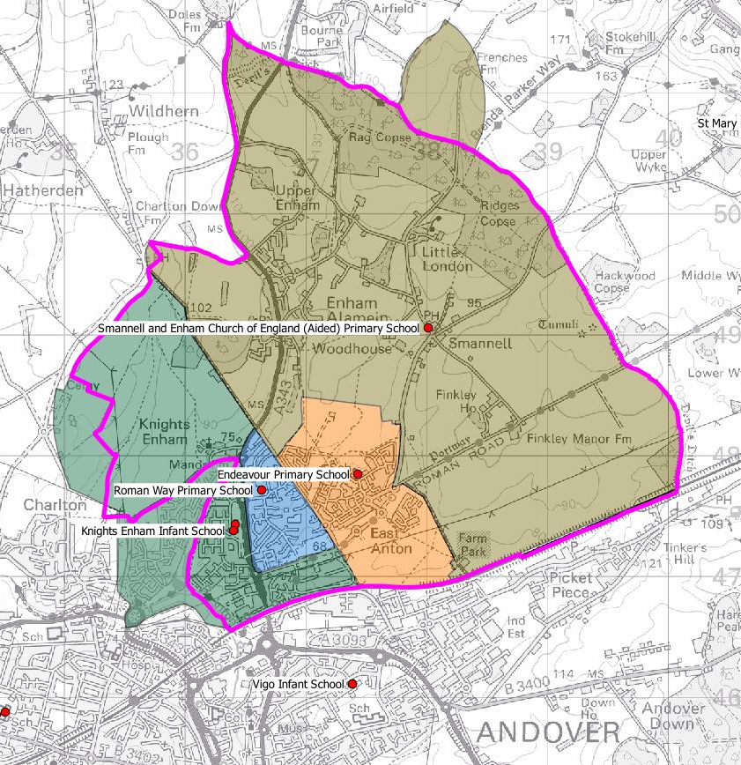
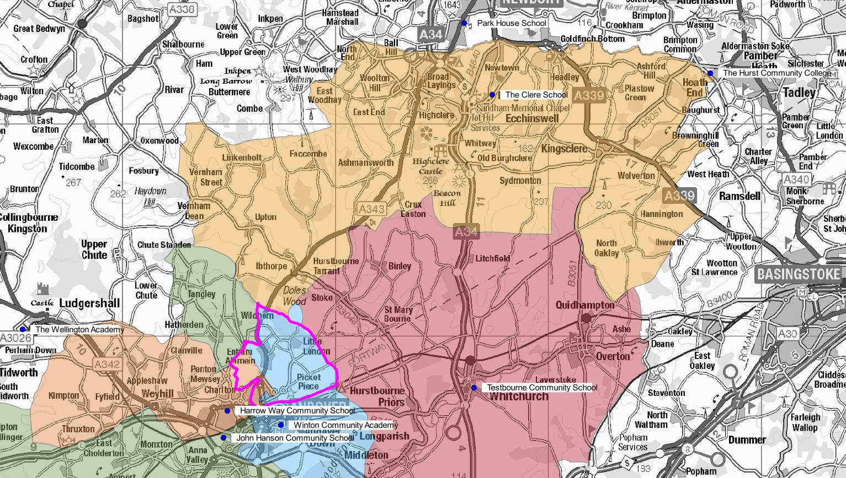
Understanding the area: Schools
School | OFSTED Rating | Average Point Score (KS2)
Smannell and Enham | Good | 30.1
Endeavour | Good | 27.6
Roman Way | Good | 26.9
Knight’s Enham | Good | 26.7
School | OFSTED Rating | Average Point Score (GCSE)
Harrow Way | Good | 310.8
Winton | Requires Improvement | 249.3
John Hanson | Requires Improvement | 361
The Clere School | Good | 375.5
Testbourne | Outstanding | 415
Park House School | Good | 404.4
Alamein secondary catchments
Alamein primary catchments
We are however able to map catchment areas for:
Primary schools
Secondary schools
Notes:
We know the schools and all their catchment areas

Slide 22
Understanding the area: Schools
School | Est number in school from this ward per year to nearest 5 | Proportion of Alamein pupils attending school
Harrow Way Community School | 45 | 0.50%
John Hanson Community School | 5 | 0.05%
Park House School | 15 | 0.17%
Winton School | 25 | 0.28%
We know how many students from the ward go to each secondary school.
Notes:
We know the numbers from the ward attending each school.
I think this can be helpful. The geographical focus of the HEFCE data and the NCOP makes us ask about the attainment of all students from a particular area.
Its clear that WP strategies in the past have often focused on just one school – the one that takes the largest proportion of local students.
Can create a rather unhelpful tensions, with one school feeling under pressure, and in response point to the number of students who opt out into other schools.
Looking at the whole cohort leads us to ask about what happens to the students that go to other schools.

Slide 23
Understanding the area: Schools
Oasis Academy Lord’s Hill
Average achievement over last 3 years
 | Non-PP | PP | Gap
5 A*-C GCSE | 54.8% (20) | 24.8% (32) | 30.0% (34)
Most similar school | 55.4% | 28.9% | 26.5%
Avg score best 8 GCSE | 32.1 (21) | 22.6 (27) | 9.4 (33)
Most similar school | 32.2 | 23.1 | 9.1
We can examine the performance of each local secondary school against its most similar family of schools.
The example here shows Oasis Academy to perform as well as its most similar school in terms of non PP students, but that it underperforms against its most similar school in terms of PP students.
Notes:
We can examine the performance of each local secondary school against its most similar family of schools. (Education Endowment Foundation.
The example here shows Oasis Academy to perform as well as its most similar school in terms of non PP students, but that it underperforms against its most similar school in terms of PP students.

Slide 24
Understanding the area: Schools
Magna Academy (Newtown)
Average achievement over last 3
St. Aldhelm’s Academy (Newtown)
Average achievement over last 3 years
 | Non-PP | PP | Gap
5 A*-C GCSE | 63.3% (8) | 47.6% (2) | 15.7% (5)
Most similar school | 38.5% | 19.8% | 18.7%
Avg score best 8 GCSE | 32.0 (26) | 28.1 (7) | 3.9 (2)
Most similar school | 28.8 | 20.5 | 8.4
 | Non-PP | PP | Gap
5 A*-C GCSE | 67.4% (18) | 47.8% (9) | 19.6% (8)
Most similar school | 66.3% | 46.9% | 19.4%
Avg score best 8 GCSE | 42.2 (11) | 36.2 (3) | 6.0 (3)
Most similar school | 43.7 | 32.9 | 10.8
We can examine the performance of each local secondary school against its most similar family of schools.
The example shows that Magna Academy outperforms its most similar school whereas St. Aldhelm is more consistent with its most similar school.
Notes:
The example shows that Magna Academy outperforms its most similar schools on both pupil premium and non-pupil premium students, whereas St. Aldhelm is more consistent with its most similar school.
The point, perhaps, is that it may be unrealistic to expect significant improvement from a school that is already the best performing of schools with a similar intake.
But more realistic where schools are average or week in their famiiy.

Slide 25
Understanding the area: Schools
St. Anne’s Catholic School (Coxford)
Average achievement over last 3 years
Redbridge Community School (Coxford)
Average achievement over last 3 years
 | Non-PP | PP | Gap
5 A*-C GCSE | 78.5% (26) | 47.3% (41) | 31.2% (46)
Most similar school | 86.5% | 72.2% | 12.2%
Avg score best 8 GCSE | 48.1 (12) | 38.1 (24) | 11.0 (34)
Most similar school | 49.1 | 44.9 | 4.2
 | Non-PP | PP | Gap
5 A*-C GCSE | 43.1% (40) | 29.0% (20) | 14.1% (4)
Most similar school | 51.4% | 25.7% | 25.7%
Avg score best 8 GCSE | 28.9 () | 23.0 () | 5.9 (7)
Most similar school | 28.9 | 20.7 | 8.2
We can highlight issues relevant to deprived LSOAs such as variance in performance of pupil premium and non pupil premium students.
The example shows St. Anne’s Catholic underperforms in terms of PP students compared with its most similar school, whereas Redbridge Community outperforms its most similar school.
Notes:
In this case we have two schools serving the Coxford ward.
St Annes underperforms in relation to PP students,, Redbridge overperforms.
As we shall see from Ceri’s presentation, the performance of PP students compared with others is a significant issues, but also a challenge that varies considerably from school to school and ward to ward.
One advantage of looking at all the schools serving an area is that it challenges to tendency to focus on just one school that may be a major school for an area and makes us ask what is happening to all the children from the area.
The most similar schools data does not let us know what happens to a PP cohort from a particular area, but this is something that can be followed up locally.

Slide 26
Understanding the area: Post 16
Paulsgrove
We can examine the destination of students post 16
This may indicate the willingness of young people to enter work with or without formal training.
Notes:
The post 16 data – not open data but we found LAs very willing to share the data they have collected for NEET reporting to DfE.
Can highlight a number of useful issues.
Here we have highlighted those not going to FE/6th form
Give an indication of those who go quickly into work – with or without training.
Over three years, of the economically active cohort which averages around 200 a year from Paulsgrove,
92 in apprenticeship with training
81 in employment with no training
21 in higher education.
May of course raise questions about whether degree apprenticeship would usefully meet the culture in this areas.

Slide 27
Understanding the area: Post 16
Paulsgrove
We can examine the destination of students post 16
We can highlight the number of students who leave FE after only one year.
Notes:
And we see a high attrition rate from FE
Not the same cohort, but lose roughly one third each year, and of 180, might expect only 21 to enter HE by 19.

Slide 28

Developing a localised WP strategy
Taken together the data enables us to take a structured approach to a localised strategy. The data does not determine the strategy, but should focus discussion on the key issues. It should enable a constructive challenge to possible complacency about current performance.
Notes:
And this is where I should hand over to Ceri.

Slide 29

How ambitious do we need/want to be?
Does the ward require incremental or transformational interventions in order to achieve our targets? Could we/should we aim for more and over what period?

Slide 30

Identifying the key groups of students
Those who already achieve reasonable GCSEs need to be identified and supported through secondary school and college. Greater attention will need to be given to those from the lowest participation LSOAs

Slide 31

Improving school/college outcomes
Schools with poor pupil premium performance need to be given greater support to improve
Support should also be given to help schools focus on students from their ward and those LSOAs where greatest attention is needed.
Colleges need to be supported to identify students from the ward of interest to raise ambitions and minimise drop out.

Slide 32

Parental engagement with education
Where it appears valuable to improve parental engagement with education, the data helps identify where this might be:
Across the ward
Targeted at LSOA areas
Developed with the social housing providers
Developed with employers

Slide 33

HEI Interventions
This approach should enable HEIs to target their interventions including student and parental outreach, support for educational opportunities (such as degree apprenticeships), work with FE institutions & support for schools.

Slide 34
Work with partners
The approach should enable more focused partnerships with local authorities, social housing providers, key employers etc.

