Slide 1
DIY Localised Strategies
Ceri Nursaw
www.nursawassociates.com

Slide 2
What this session will cover
The data, and what it tells you
Understanding the education landscape
Context from local stakeholders
Context from research and evaluation
Developing the strategy

Slide 3
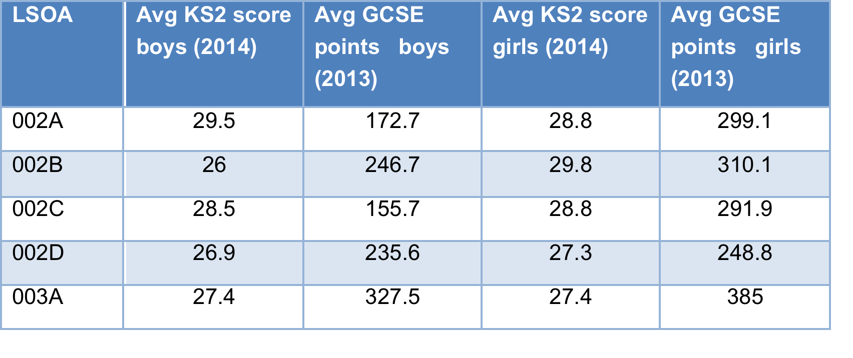
What can you learn from the data
Education context
Post-16 progression
Higher education progression
Key stage 2 and GCSE results
Differences between boys and girls
LSOAs
School performance
Pupil premium students
Similar schools
Family of schools
Graduate parents

Slide 4
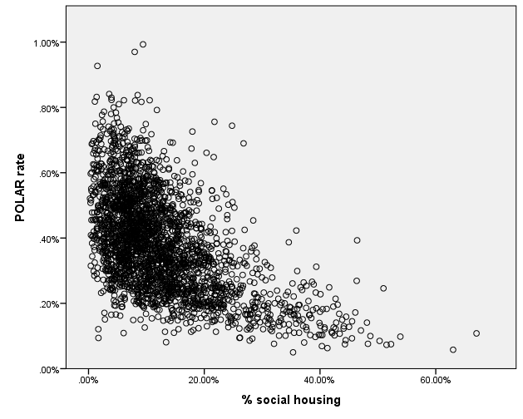
What can you learn from the data
Economic context
Economic activity rates
Type of employment
Qualification levels
Social context
Social housing
Place of birth

Slide 5
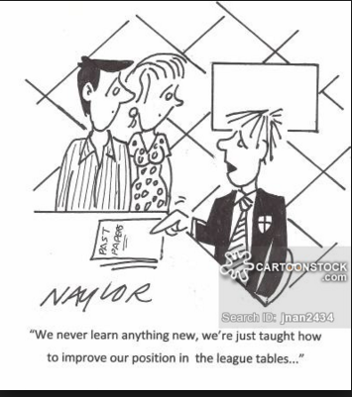
Understanding the education landscape
Ofsted reports
Education Endowment Foundation
Family of Schools database
School and college websites

Slide 6
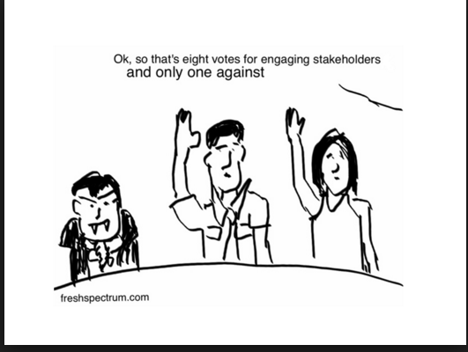
Contextualising with local stakeholders
Education professionals
School and college staff
Councillors and local authority staff
Widening participation staff in higher education
Educational bodies

Slide 7
Contextualising with national research
What works and what doesn’t
Provides weight to your recommendations
Good sources
Education Endowment Foundation’s Teaching and Learning Toolkit
Social Mobility and Child Poverty Commission
Office for Fair Access and the Higher Education Funding Council for England

Slide 8
Developing the strategy
What do you want to achieve
Strong narrative
Evidential base
Identification of challenges
Interventions
Prioritise
Identify some easy wins

Slide 9
Some questions
Do you think this would work in your context?
Would you adopt this approach?
Will you change anything from today?

